Slide 1


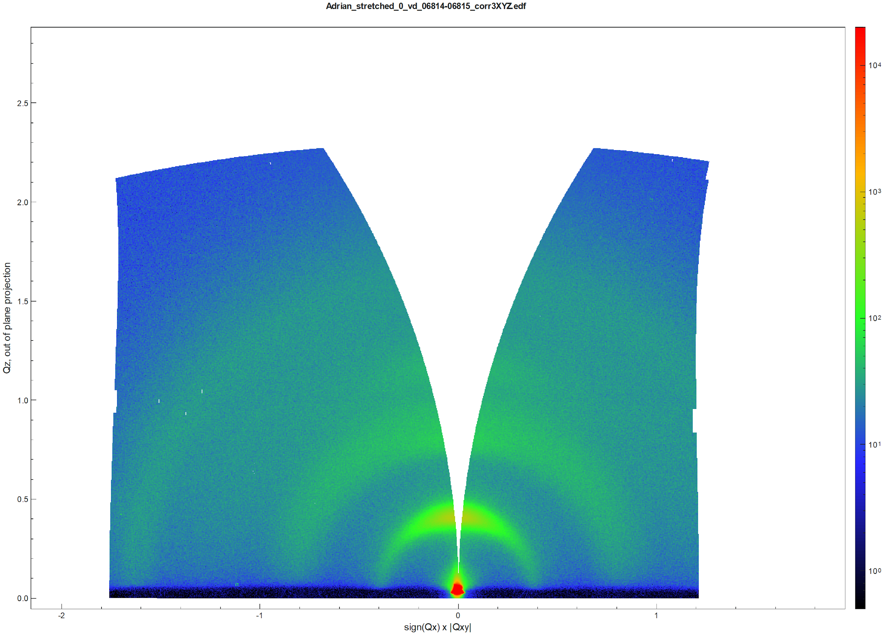
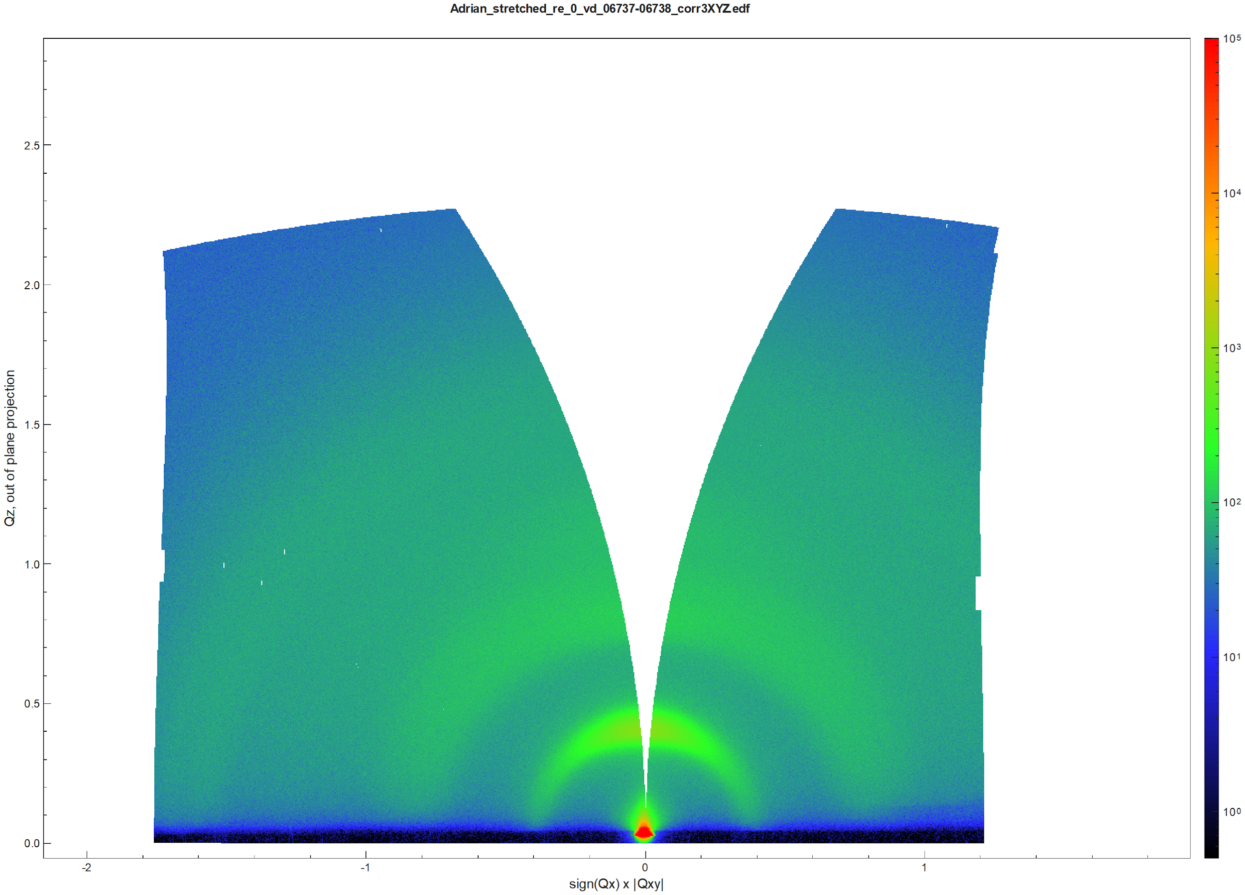
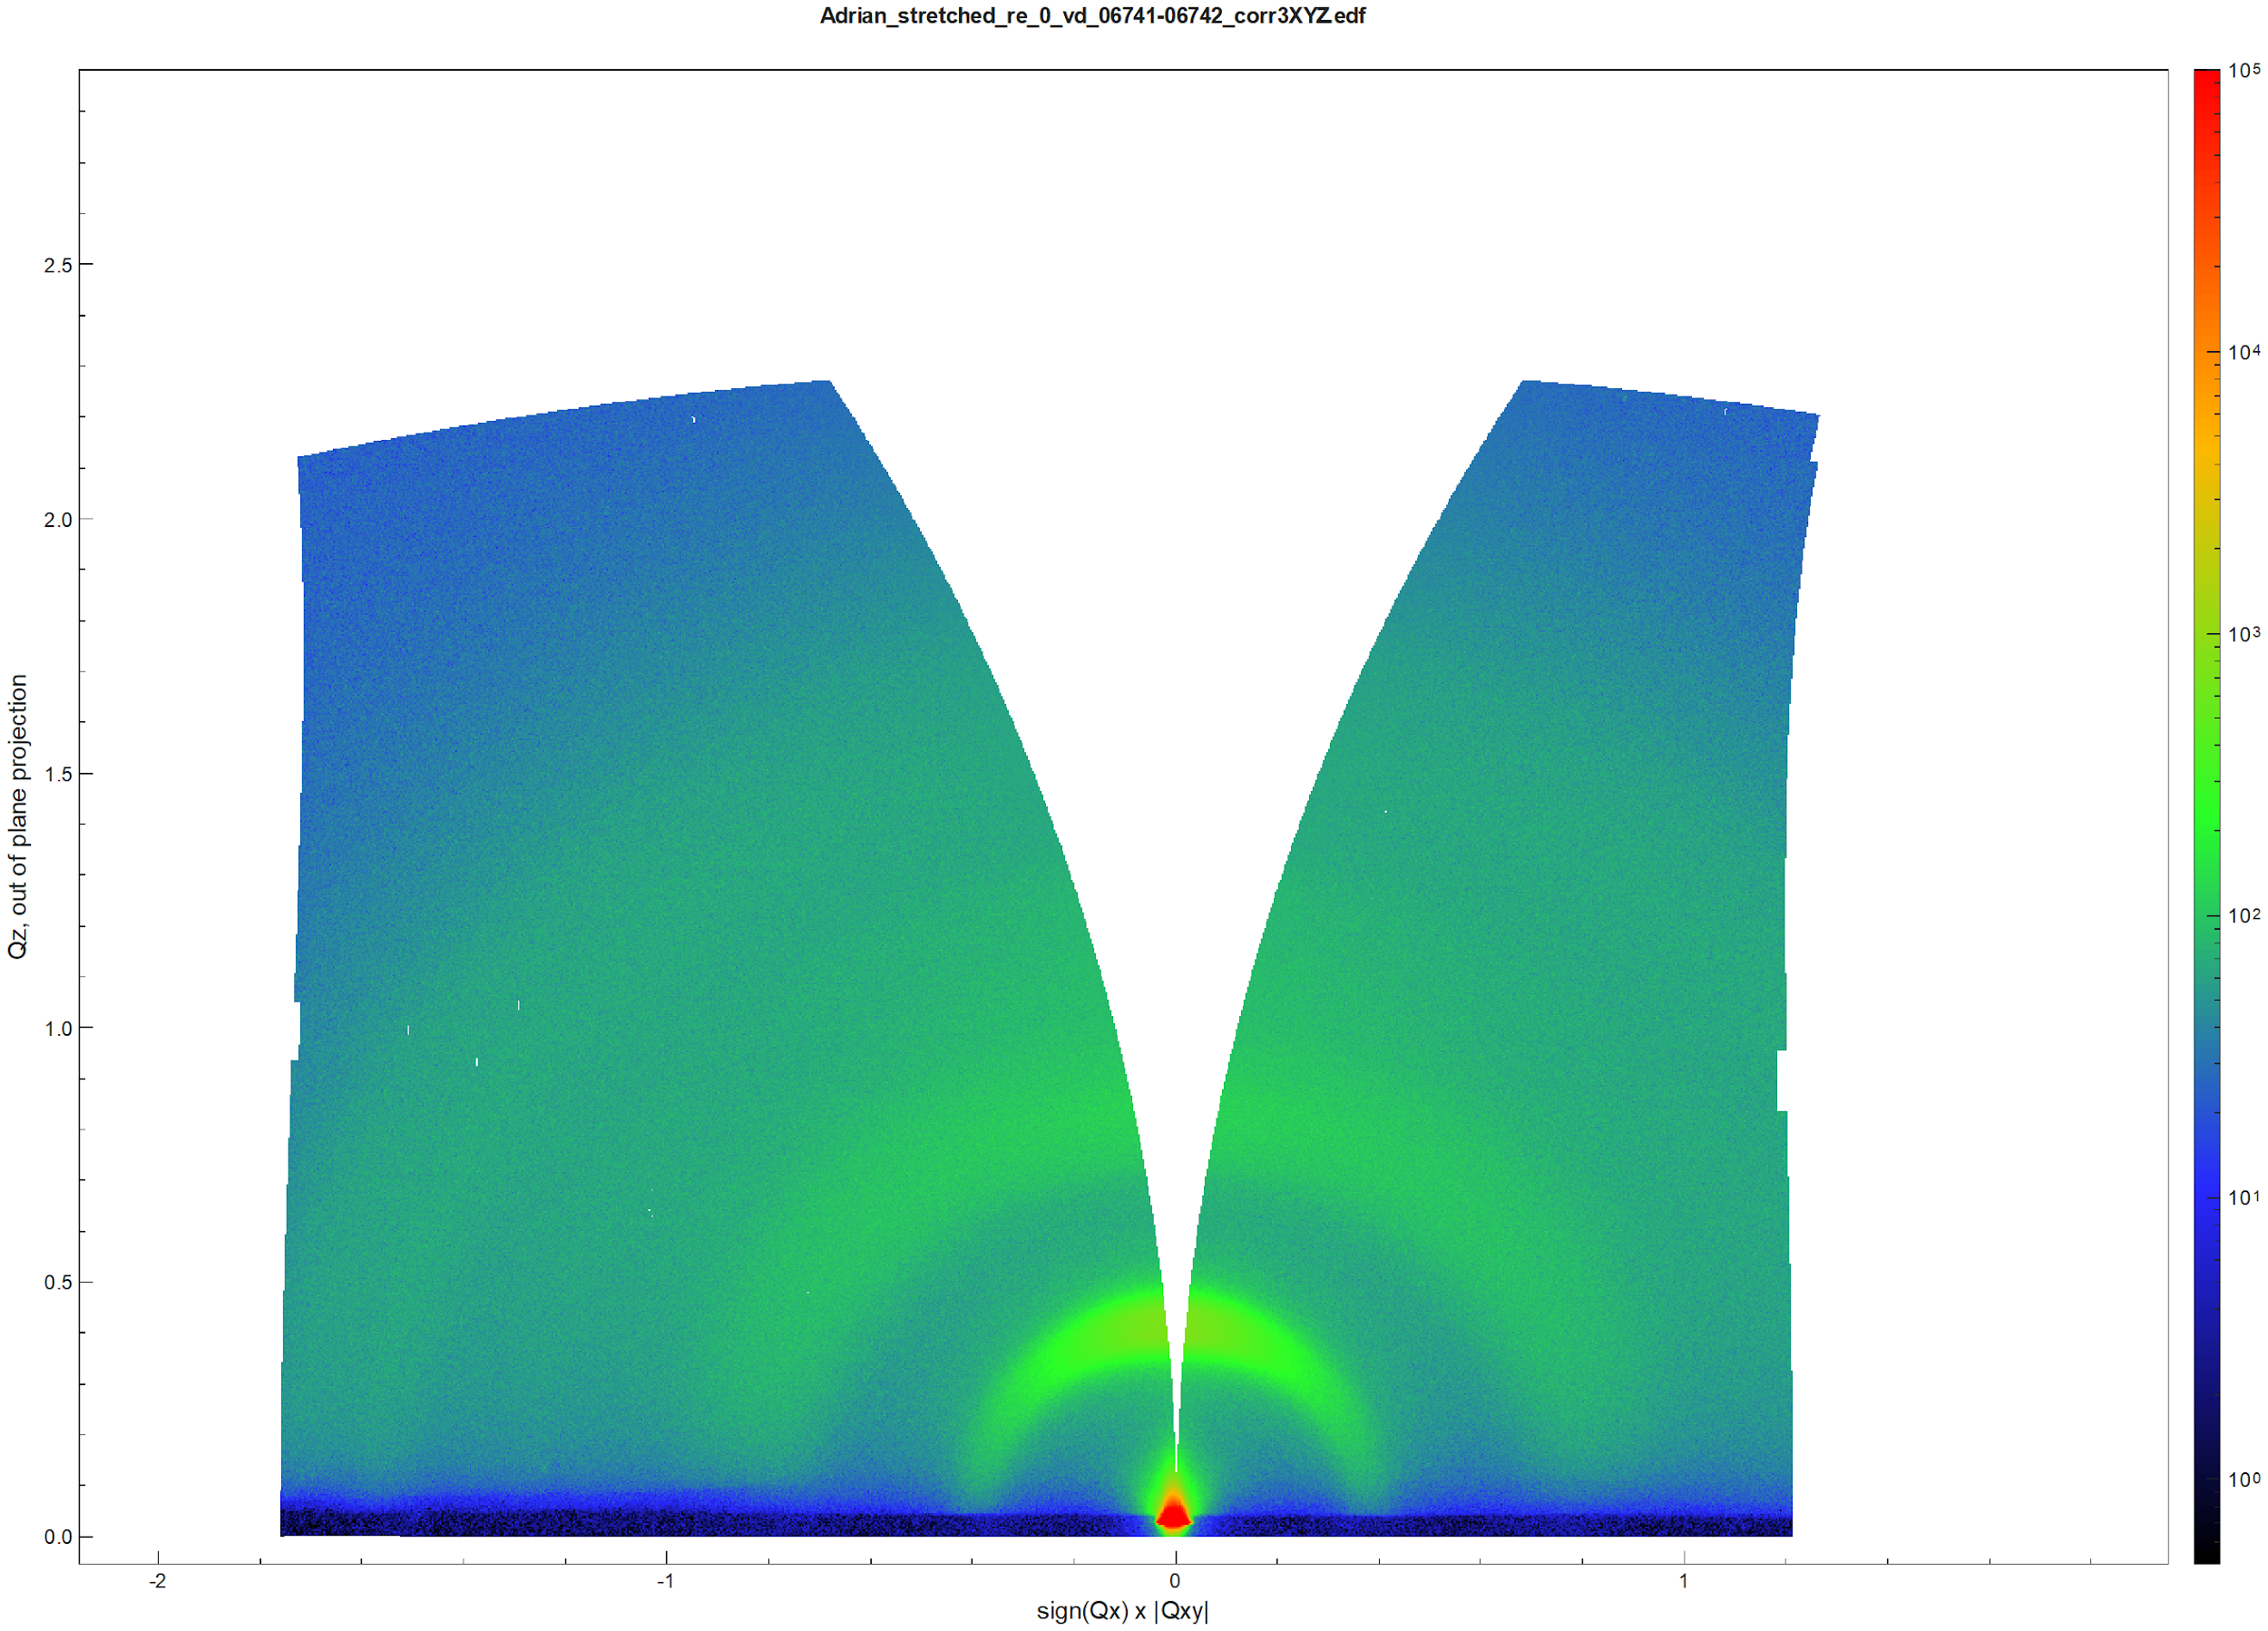
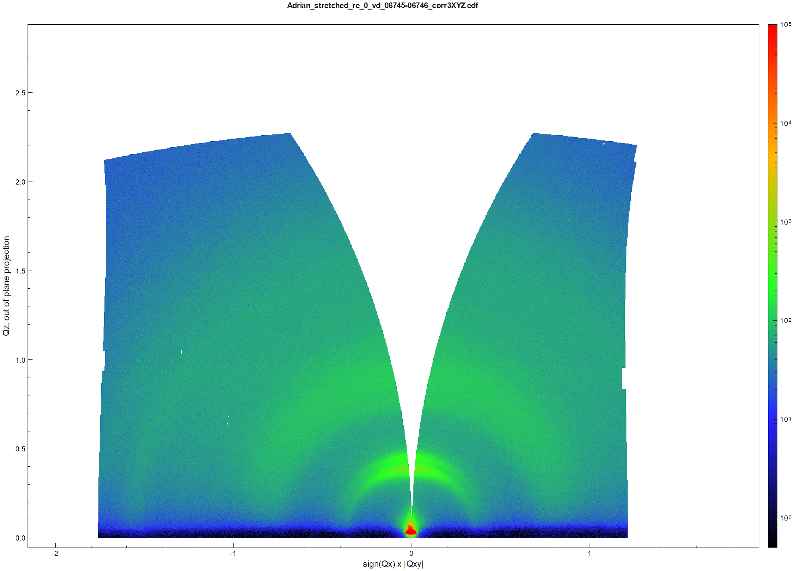
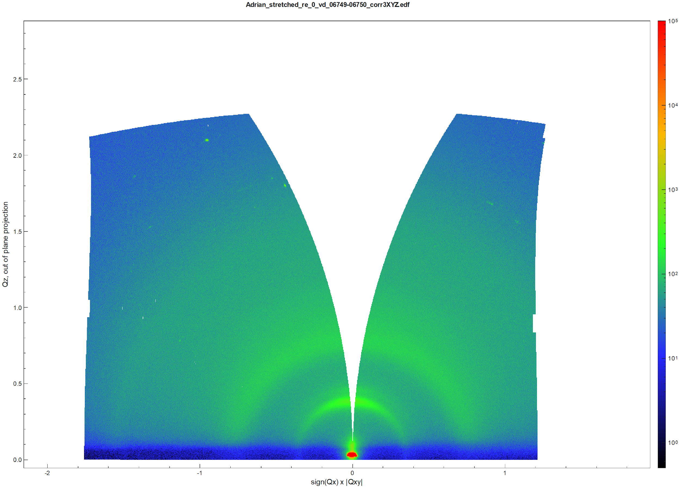
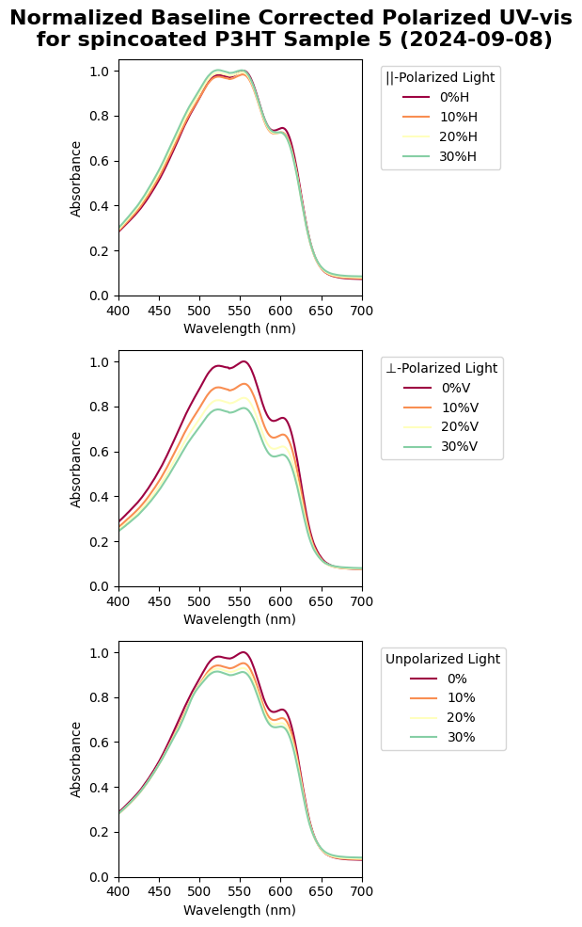
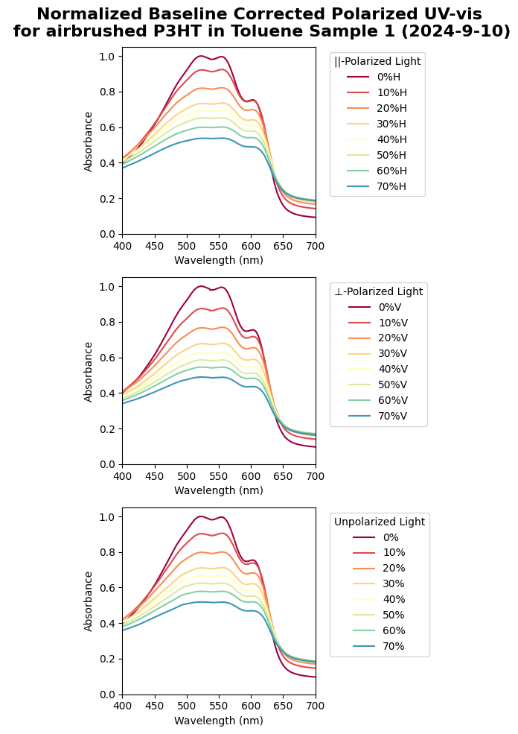
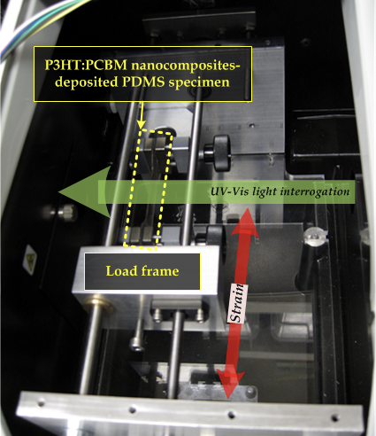
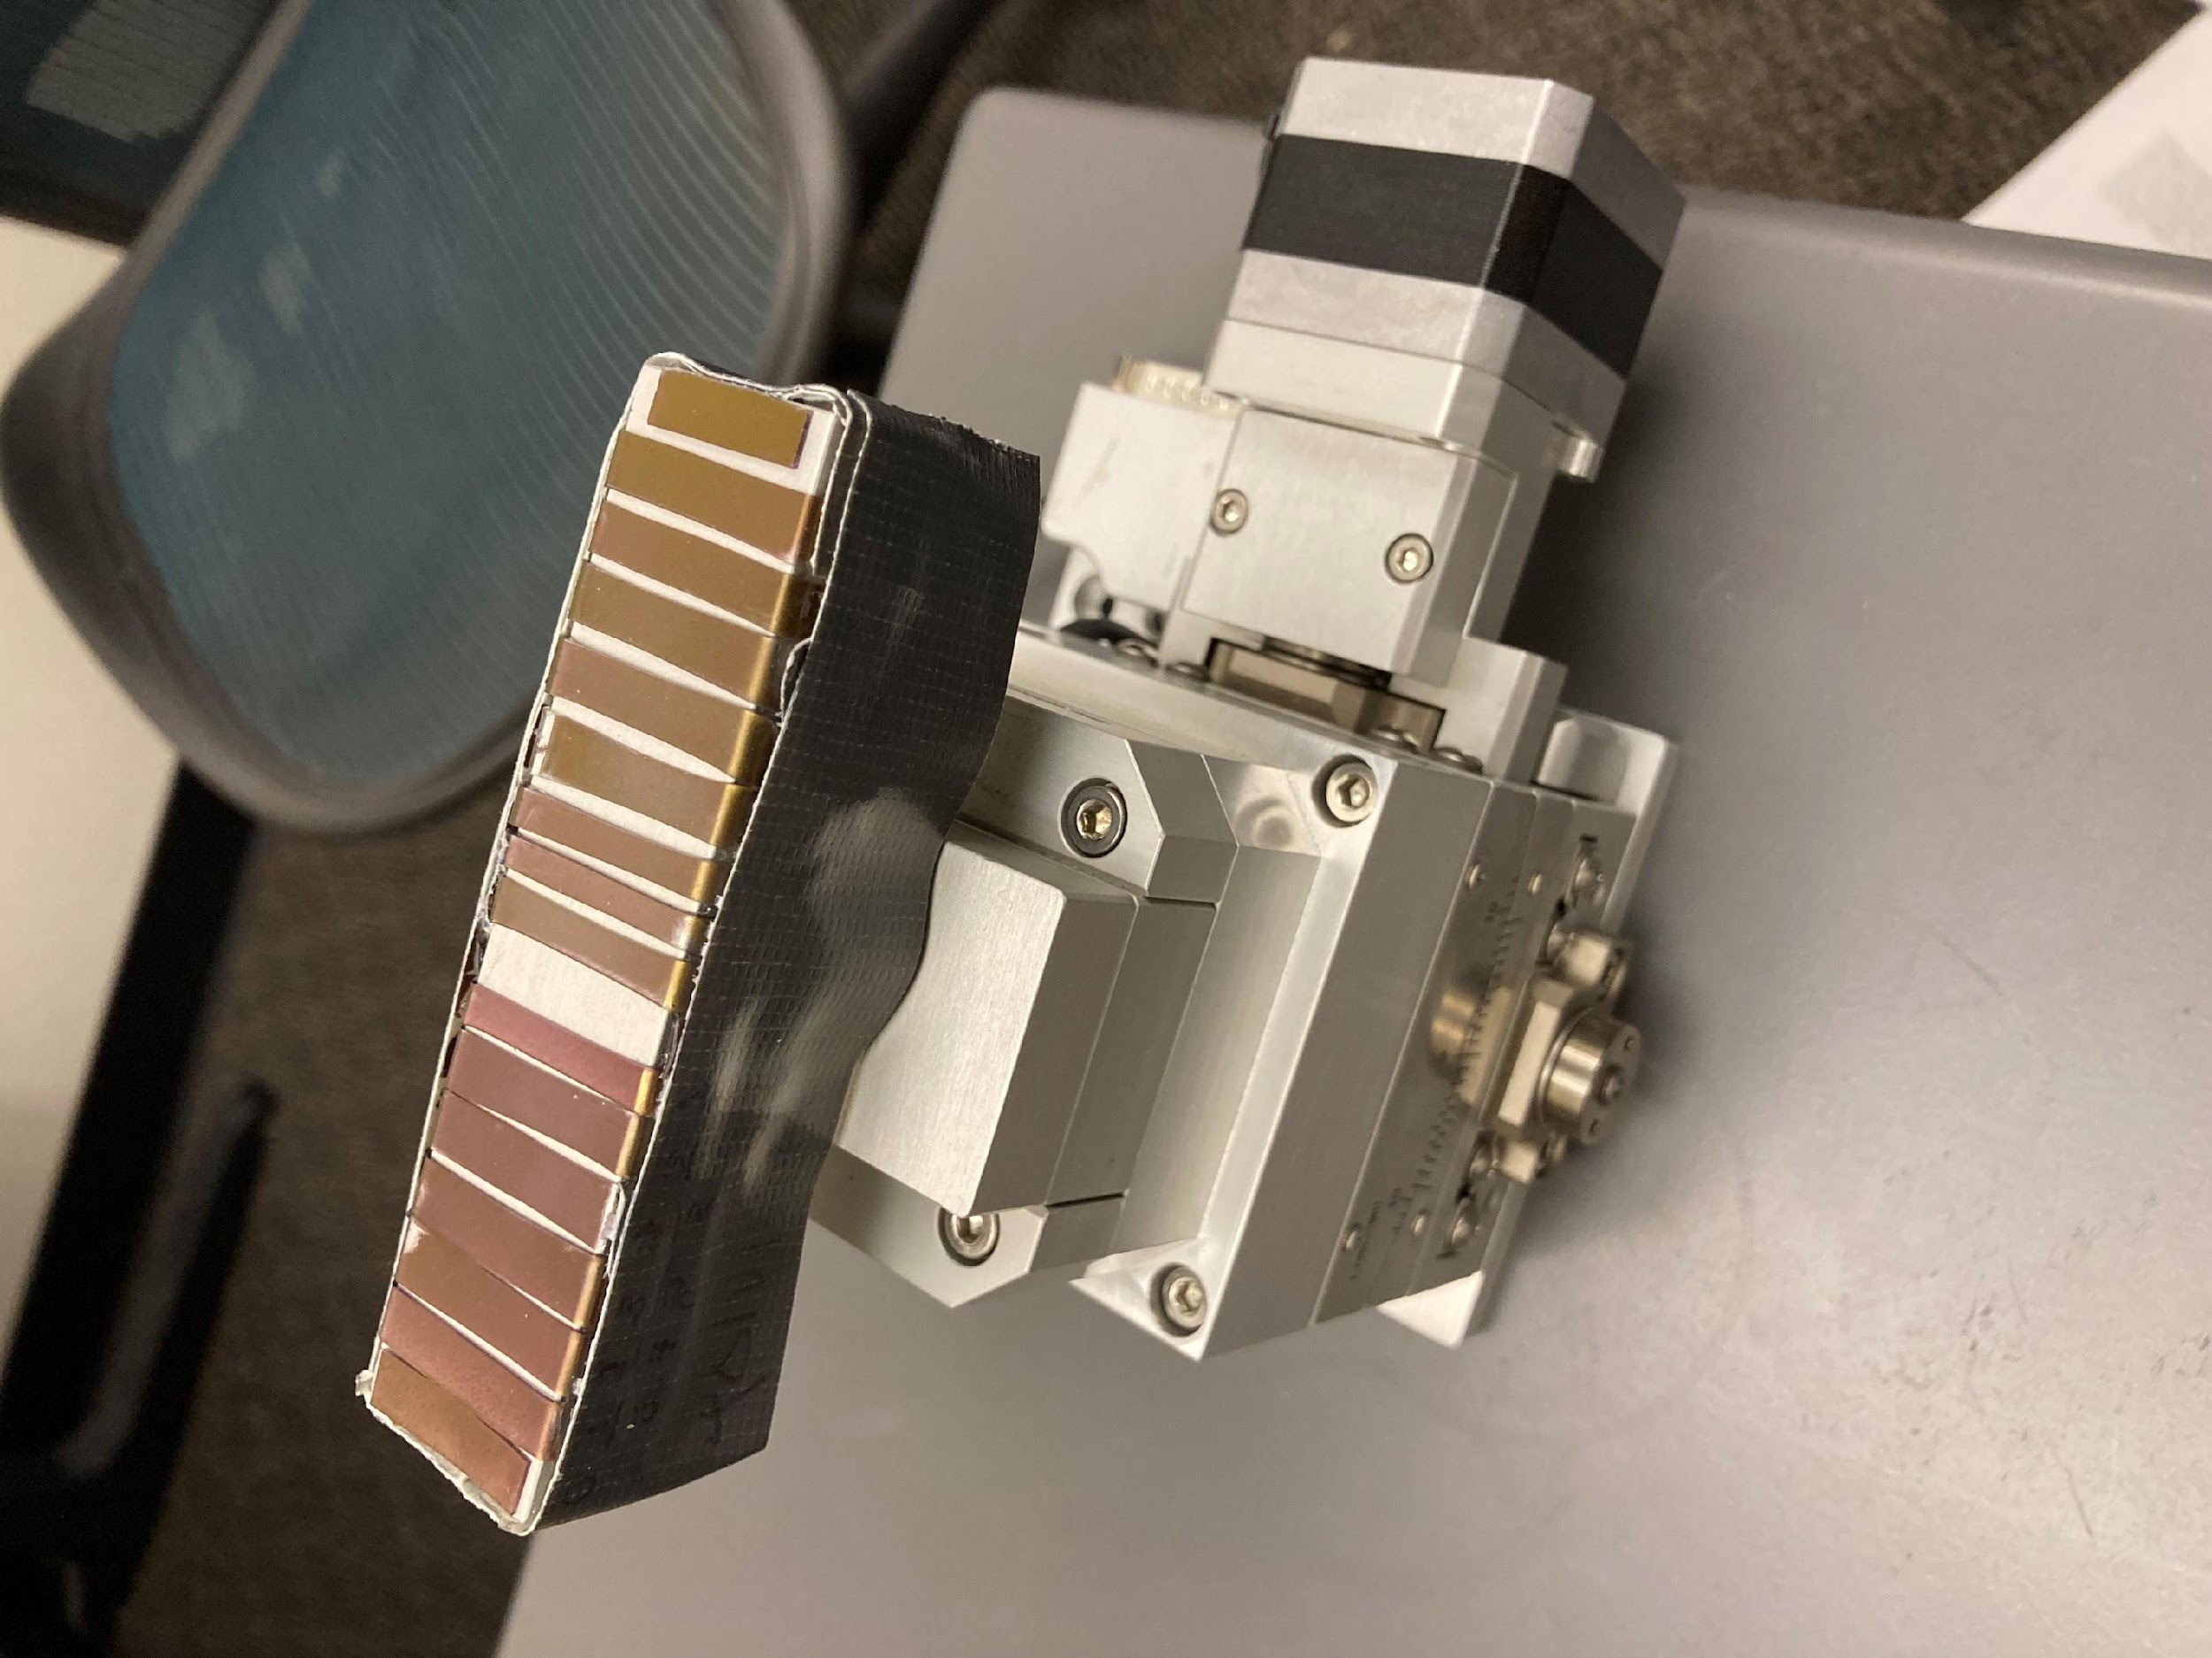
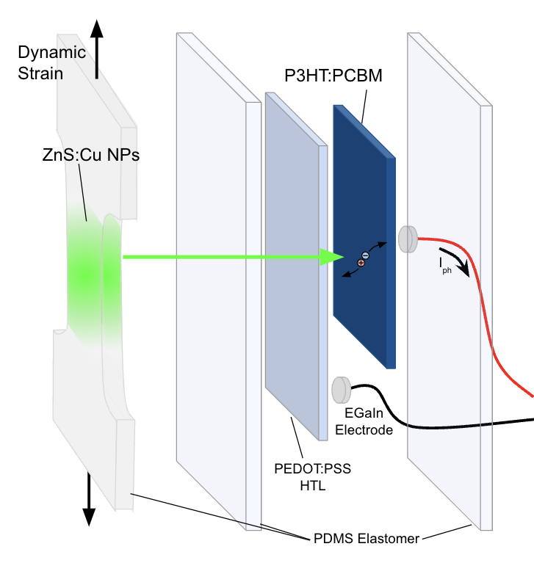
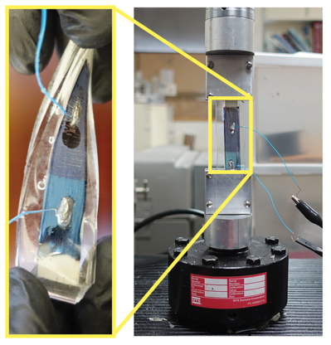
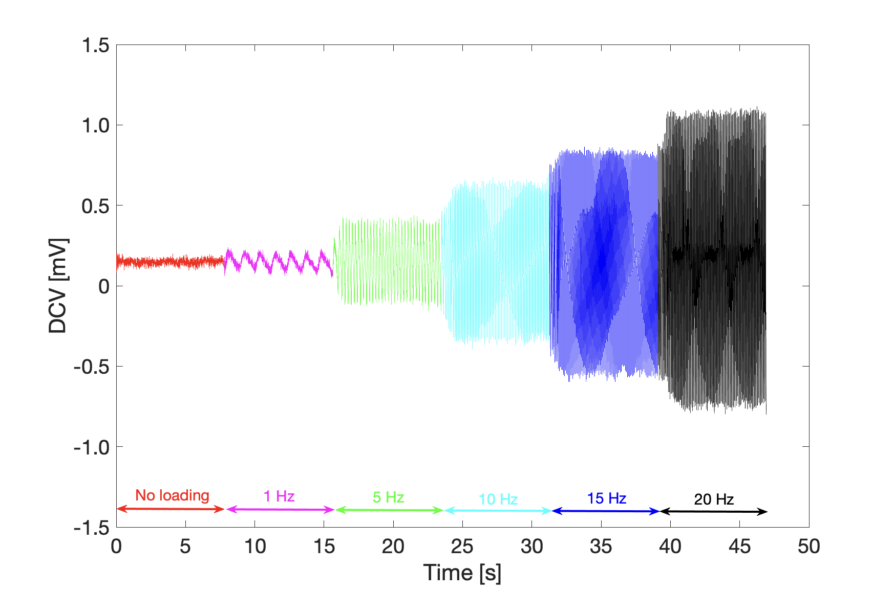
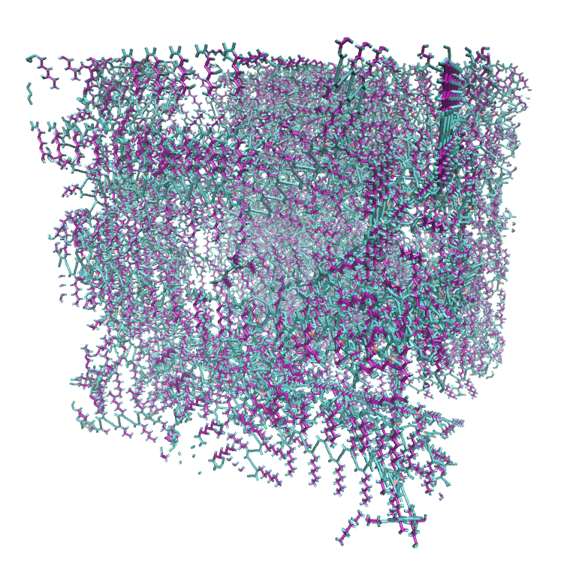
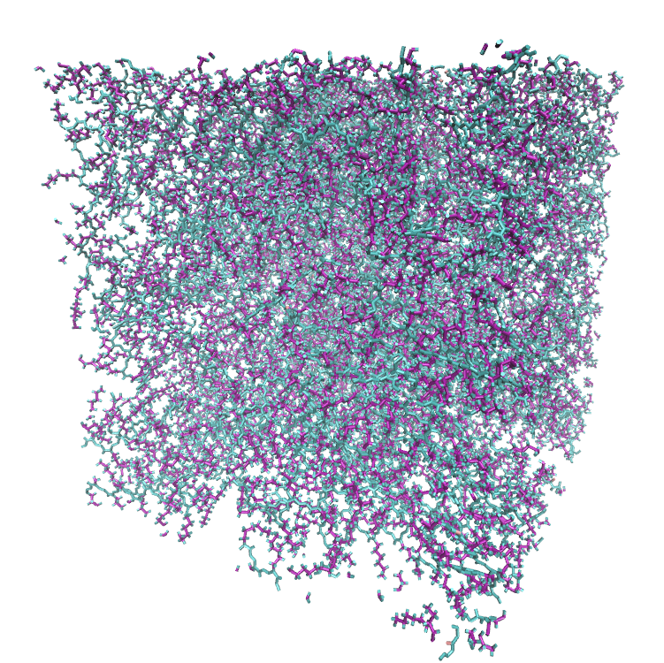
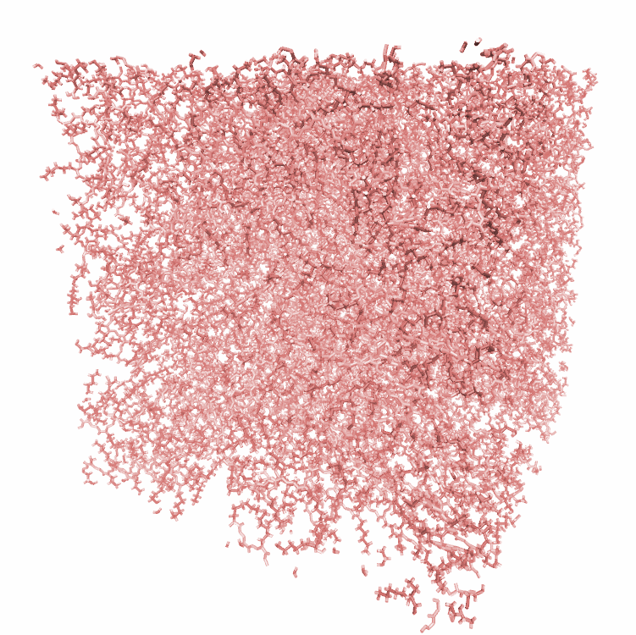
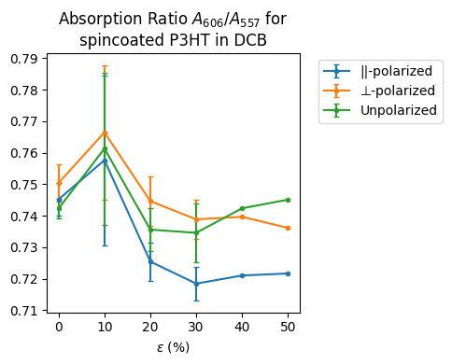
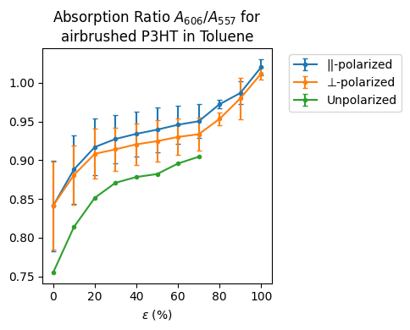
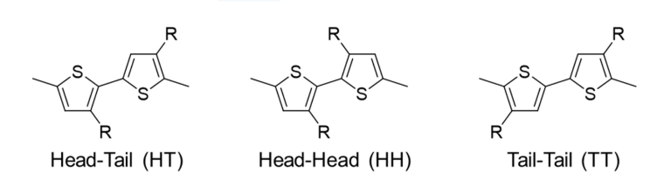
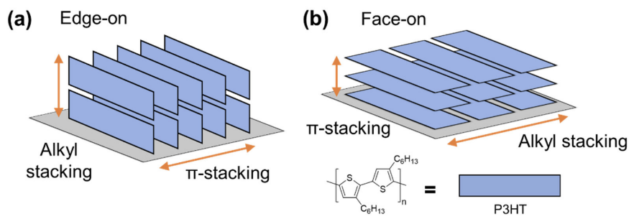
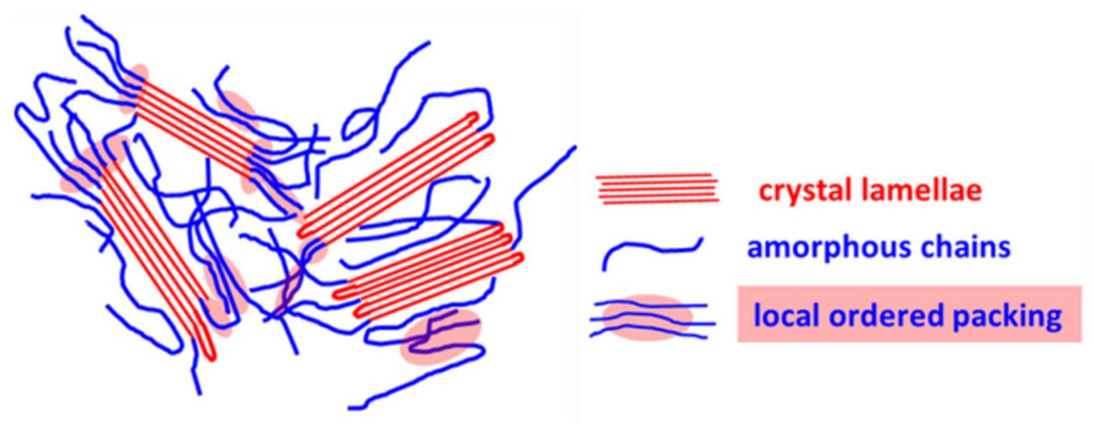




Characterization of Strain-induced Microstructure Changes in Poly(3-hexylthiophene) Mechano-optoelectronic Thin Films
NEW MEXICO TECH
Adrian Salustri¹, Cason Jones¹, Carlos Neri-Soto², Jayden Hogue¹, Youngmin Lee², and Kyungtae Kim³, Donghyeon Ryu^{1*}
¹Mechanical Engineering, New Mexico Tech, Socorro, NM 87801 (*E-mail: donghyeon.ryu@nmt.edu)
²Chemical Engineering, New Mexico Tech, Socorro, NM 87801
³MPA-CINT, Los Alamos National Lab, Los Alamos, NM 87545
Research Objectives
Nanostructure under Mechanical Deformation
Understand nano-structures of conjugated polymers of mechano-optoelectronic (MO) thin films subjected to mechanical deformations
Uncover the process-structure relationship for the MO thin films fabricated using spin-coating and airbrushing techniques to achieve target functionalities
Establish a scalable fabrication system for the MO thin films for health monitoring wearables.
0% strain
25% Strain
50% strain
75% Strain
100% strain
4q*
3q*
2q*
q*
d=1.67nm
Multifunctional composite thin-films for strain sensing
d=1.58nm
Conjugated polymers and nanoparticles dispersed in elastomers can demonstrate electronic and optical properties that strongly depend on mechanical strain.
These effects can be combined to create strain sensors with novel properties like self powering and large strains sensing.
Mechano-optical
Mechanical strain effects optical absorption.
Mechanoluminescence
Mechanical Stress causes the emission of photons
a) Preliminary small angle X-ray scattering (GISAXS) of air-bushed P3HT thin films on PDMS at different tensile strains. Shows a (face-on) lamellar structure with d=1.58nm. There is a reduction in anisotropy as the q* peak spreads into q_{xy}. b)The beam was incident parallel to the strain. direction.
Piezoresistance
Strain changes charge transport properties.
Piezoelectricity
Mechanical stress induces net electrical polarization
Strain Direction
Beamline
a) Schematic of a multifunctional strain sensor. ZnS:Cu nanoparticles dispersed in PDMS emit photons in response to strain, detected by a coincident P3HT:PCBM cell (whose efficiency increases under strain). PEDOT:PSS and EGaIn electrodes exhibit piezoresistivity, enhancing the sensor's sensitivity. (b) Image of the fabricated sensor during cyclic tensile testing. (c) Time series of P3HT:PCBM open-circuit voltage (Voc) at various dynamic strain frequencies.
Microstructure of P3HT
(a) Polarized UV results for spin-coated P3HT on PDMS. (b) Peak absorbance ratio (A0-0/A0-1) vs. strain. (c) Photograph of polarized UV-Vis setup with in-situ load frame.
Regioregular P3HT thin films can show lamellar structure via 𝛑-𝛑 stacking.
Charge transport is typically anisotropic, with better conductivity along the polymer backbone.
Initial Condition
Simulate at STP
Strain Bounding Box
Preliminary tensile testing results from molecular dynamics simulations in LAMMPS. A semicrystalline starting condition is simulated at STP for 10 ps, followed by straining the bounding box to ε_{xx} = 10% over an additional 10 ps.
Future Work
Airbrushing of P3HT will be optimized with CFD simulation, as well as gantry.
GISAXS of sample strained perpendicularly to beam line will be tested (90deg rotation in XY plane) This should illuminate the possible anisotropy suggested by UV-vis.
LAMMPS simulations will be further developed to replicate lamellar structure and to yield quantitative data like mechanical moduli, crystallinity and work function.
Schematics of P3HT Nanostructures (Lee, 2021)
Acknowledgements: The author thanks CINT User Program (LA-UR-23-30556), NASA EPSCoR CAN (grant #: 90NSSC23M0069 and 80NSSC17M0050), and NASA's Space Grant College and Fellowship Program for supporting this research.
[1] Y. Lee, A. Mongare, A. Plant, and D. Ryu, “Strain–Microstructure–Optoelectronic Inter-Relationship toward Engineering Mechano-Optoelectronic Conjugated Polymer Thin Films,” Polymers, 2021

